Slide 1
Lesson objective
Need whiteboards
PBiS focus: Achieve
- Completing all tasks
Title: Combination of transformations
Aim:
Identify multiple transformations
Rotate objects about an origin
Plan:
Review probability
Mixed transformations

Slide 2

Review probability
Sample space is a list of all possible outcomes.
Probability of an event (something happening) =$\frac{how many ways it CAN happen}{Total number of possibilities }$
WHITEBOARDS
If rolling an 8-sided die:
What is the sample space?
Probability of rolling a 7?
Probability of rolling a number less than 6?

Slide 3
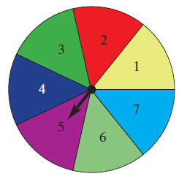
Probability: whiteboards
What is the sample space?
P(green)?
P(red or green)
P(not purple)

Slide 4
Probability expectations
There are 5 marbles in a bag. Blue and yellow are equally likely and there is only 1 red marble.
If we were to do 20 experiments, how many of each colour would we expect to see?
Colour | Red | Blue | Yellow
Frequency

Slide 5
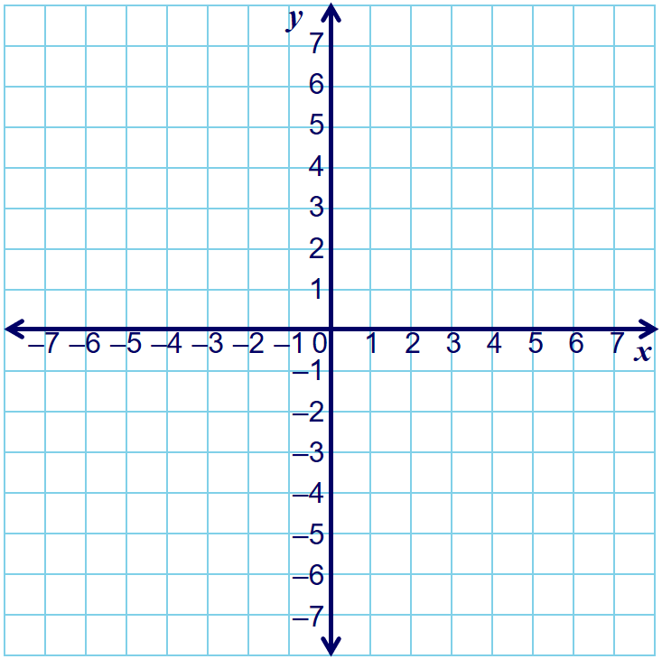

I DO
Step 1: sketch the image onto the baking paper
Step 2: Press the tip of your pen into the origin/rotation point
Step 3: Rotate the tracing paper (degrees clock or anti clockwise)
Step 4: sketch the new shape
A
B
C
D
Rotate the rectangle $90° clockwise$
A (0, 5)
B (3, 5)
C (0, 4)
D (3, 4)
A’
B’
C’
D’

Slide 6

We DO
Step 1: sketch the image onto the baking paper
Step 2: Press the tip of your pen into the origin/rotation point
Step 3: Rotate the tracing paper (degrees clock or anti clockwise)
Step 4: sketch the new shape
A
B
Rotate the triangle $180° anti−clockwise$
C
A (0, 5)
B (4, 4)
C (0, 3)
A’
B’
C’

Slide 7

You DO
Step 1: sketch the image onto the baking paper
Step 2: Press the tip of your pen into the origin/rotation point
Step 3: Rotate the tracing paper (degrees clock or anti clockwise)
Step 4: sketch the new shape
B
A
C
Rotate the triangle $270° anti−clockwise$
A (0, 5)
B (-4, 6)
C (-4, 4)
A’
B’
C’

Slide 8
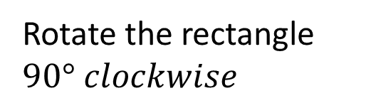
I DO
Step 1: sketch the image onto the baking paper
Step 2: Press the tip of your pen into the origin/rotation point
Step 3: Rotate the tracing paper (degrees clock or anti clockwise)
Step 4: sketch the new shape
A
B
C
D
Rotate the rectangle $90° clockwise$
A (0, 5)
B (3, 5)
C (0, 4)
D (3, 4)
A’
B’
C’
D’

Slide 9
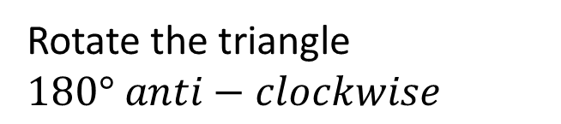
We DO
Step 1: sketch the image onto the baking paper
Step 2: Press the tip of your pen into the origin/rotation point
Step 3: Rotate the tracing paper (degrees clock or anti clockwise)
Step 4: sketch the new shape
A
B
Rotate the triangle $180° anti−clockwise$
C
A (0, 5)
B (4, 4)
C (0, 3)
A’
B’
C’

Slide 10
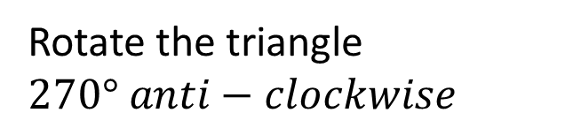
You DO
Step 1: sketch the image onto the baking paper
Step 2: Press the tip of your pen into the origin/rotation point
Step 3: Rotate the tracing paper (degrees clock or anti clockwise)
Step 4: sketch the new shape
B
A
C
Rotate the triangle $270° anti−clockwise$
A (0, 5)
B (-4, 6)
C (-4, 4)
A’
B’
C’

Slide 11
Rotation practice
Transformations – Rotations
Rotation puzzle
Positive is clockwise
Negative is anti-clockwise

Slide 12
Combination of transformations
The easiest way to perform a combination of transformations is to:
Sketch the shape onto tracing paper
Perform the first transformation
Lightly sketch that position
Perform the next transformation
Double check your answer

Slide 13
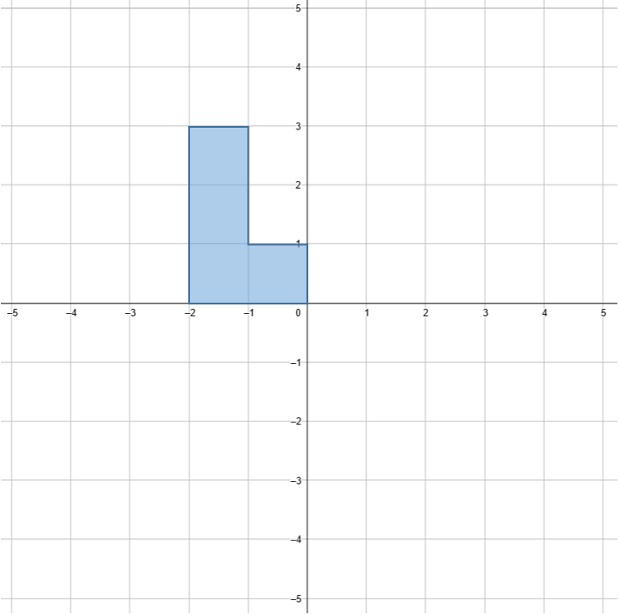
Example
Mark a dot on the shape at (-2, 3), label A
Rotate 90° clockwise, then translate 2 units right and 3 units down.
Where is point A now?

Slide 14
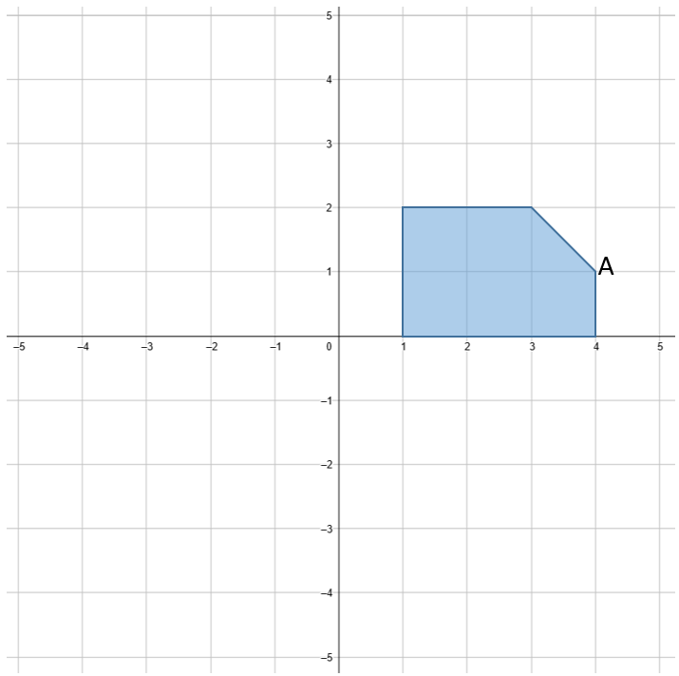
Example
Reflect about the y axis, then translate 1 unit left, 4 units down.
What is the original coordinates for point A?
What are the coordinates of A after the transformation?
Where would point A be after the original shape rotated 180°?

Slide 15
Example
Mark a dot on the shape at (-2, 3), label A
Rotate 90° clockwise, then translate 2 units right and 3 units down.
Where is point A now?

Slide 16
Example
Reflect about the y axis, then translate 1 unit left, 4 units down.
What is the original coordinates for point A?
What are the coordinates of A after the transformation?
Where would point A be after the original shape rotated 180°?

Slide 17
Example
How did this triangle get to its final position?

Slide 18
Individual practice
Finish rotation puzzle and oblique drawings from yesterday.

